Slide 1
LMRFC Reference Slide For Crest Tables
LMRFC Forecasts Issued Morning of March 25, 2022
Lower Mississippi
RIVER FORECAST CENTER
Talking Points
The heavy rain early this week has kept river levels on the lower Mississippi River elevated from Natchez, MS to New Orleans, LA.
On the lower Mississippi River, minor flooding should end at Baton Rouge, LA by the middle of next week. Minor flooding will continue for another one to two weeks from Natchez, MS downstream to Red River Landing, LA.
Rainfall from this week is causing minor rises on the lower Ohio River and Mississippi River above Cairo, IL. The rises should peak early next week and crests are expected to be well below flood stage. This rise will only slow recessions on the lower Mississippi River below Arkansas City, AR.
Minor to isolated moderate flooding continues over smaller tributaries in Arkansas, Louisiana, and Mississippi. Heavy rain for the middle of next week may cause renewed flooding for the same smaller tributaries.
The 16 day future rainfall guidance is showing a couple of rises on the lower Ohio River through the middle of April. The guidance is now showing cresting conditions on the lower Ohio River being below flood levels. The rises would prolong flooding at Red River Landing, LA and extend elevated levels on the lower Mississippi River through late April.

Slide 2
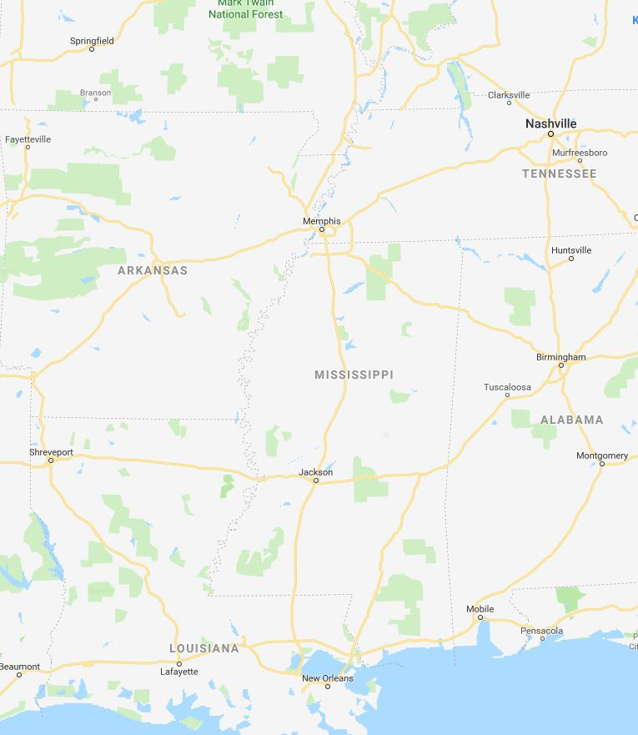
Ohio/Mississippi River Crest Watch
Created March 25 2022 @ 11:00 am CDT
Lower Mississippi River Forecast Center weather.gov/lmrfc
NWSLMRFC
@NWSLMRFC
MS River at Caruthersville
OH River at Paducah
Current: 25.4’
2 Days
Current: 29.4’
Forecast:
Slow fall for a couple of days then minor rise
Forecast:
Minor fluctuations over the next 5 days
MS River at Memphis
2 Days
0.5 Day
OH River at Cairo
Current: 21.9’
Current: 35.4’
Fall for several days before minor rise
ACTION
Forecast:
Forecast:
A minor rise and remaining above ACTION over the next 5 days
MS River at Ark City
5 Days
MS River at Greenville
Current: 32.4’
Current: 44.1’
Continue to fall over the next 5 days
ACTION
Forecast:
Forecast:
Falling and remaining above ACTION over the next 5 days
2 Days
1 Day
MS River at Natchez
MS River at Vicksburg
Current: 49.6’
MINOR
ACTION
Current: 41.7’
Forecast:
Falling and remaining above
MINOR over the next 5 days
Forecast:
Falling and remaining above ACTION over the next 5 days
2 Days
MS River at Baton Rouge
2 Days
MS River at New Orleans
Current: 35.5’
Current: 13.1’
MINOR
Forecast:
Cresting and slow falls over the next 5 days
Forecast:
Cresting and remaining above MINOR over the next 5 days
Bonnet Carré Location
Crest Location

